Slide 1
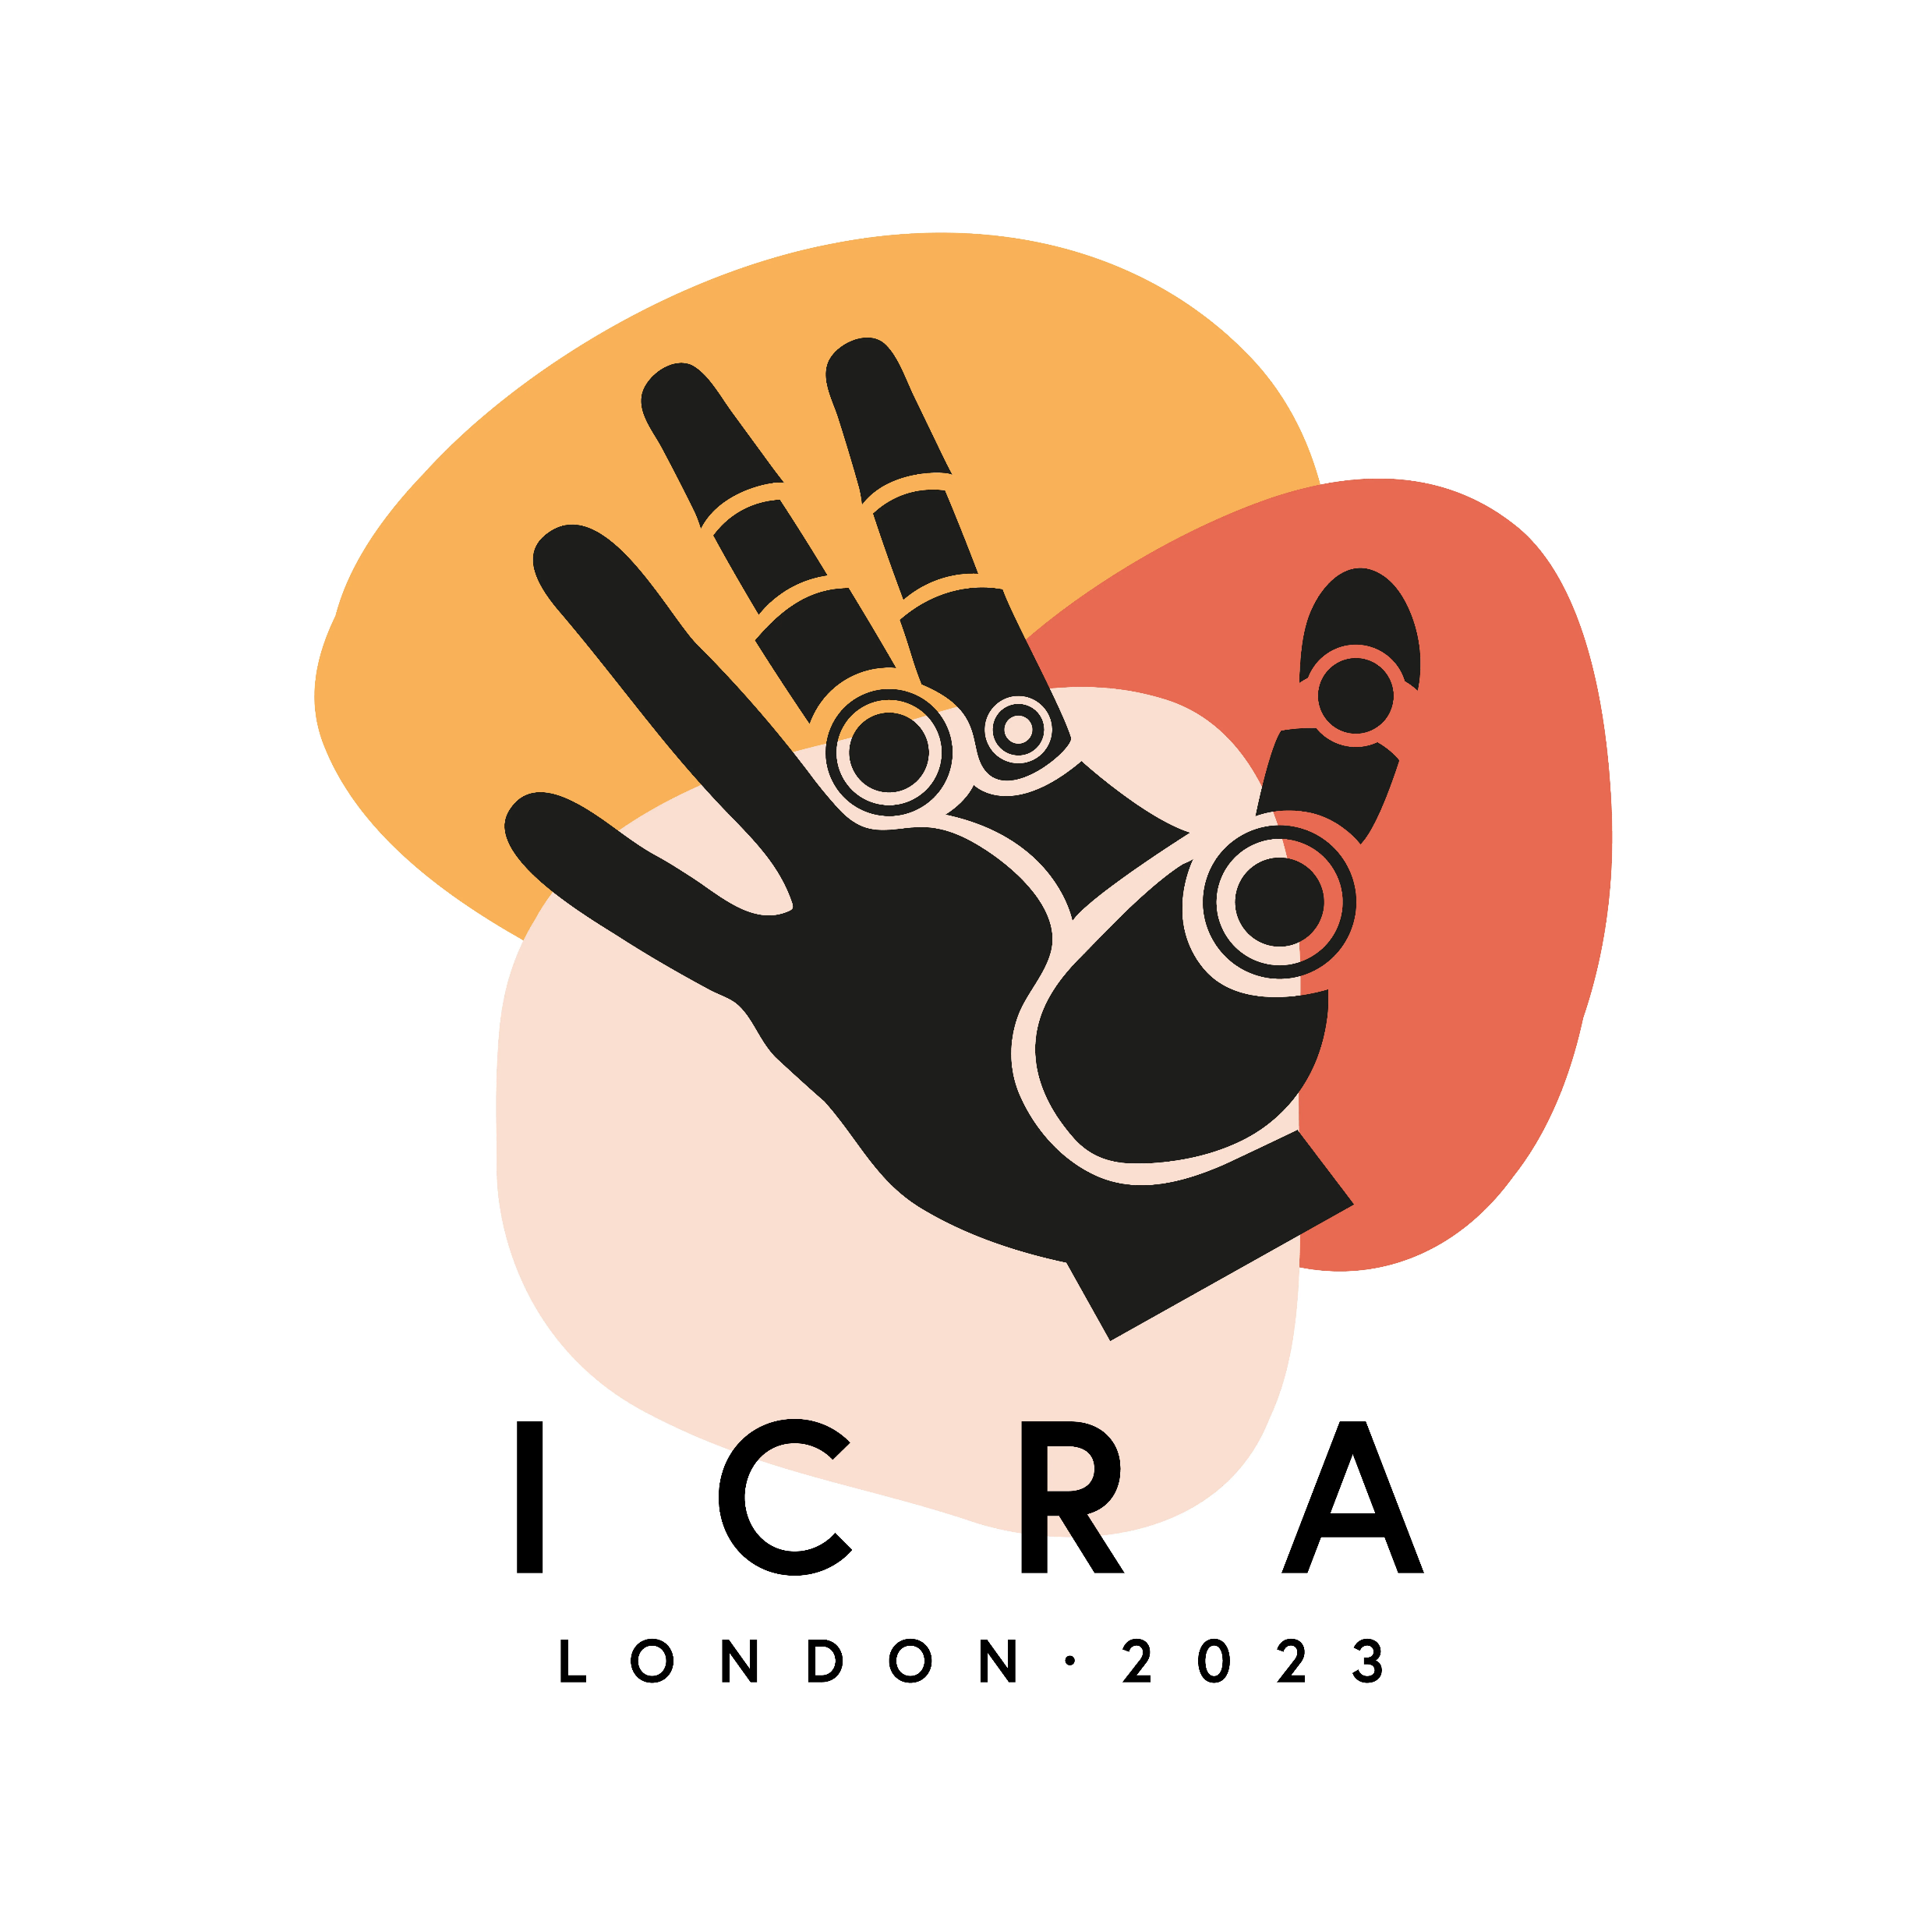
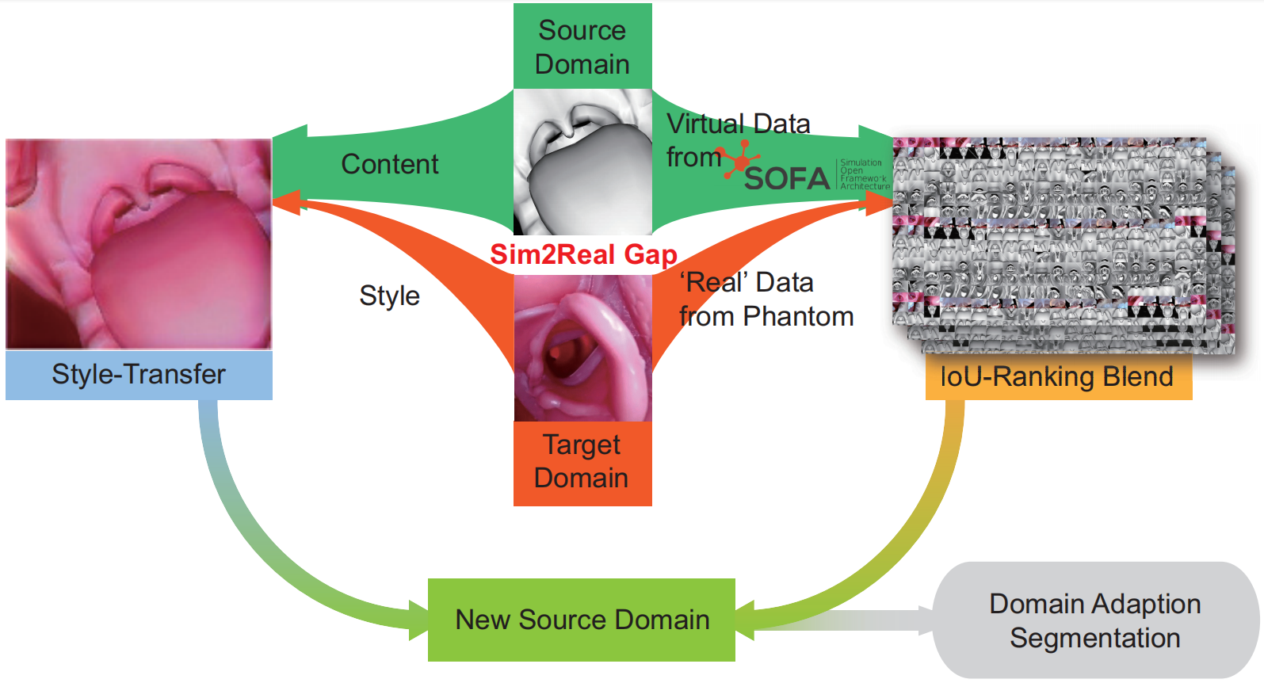
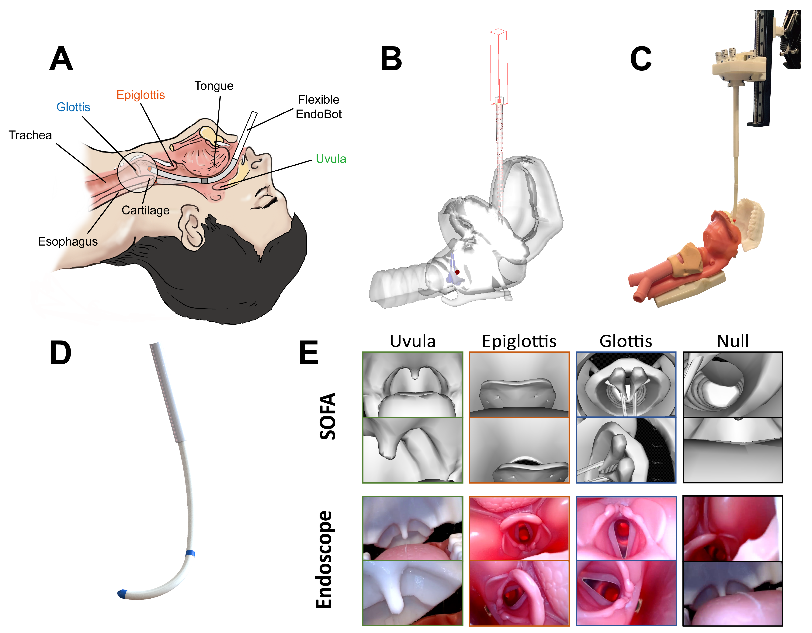
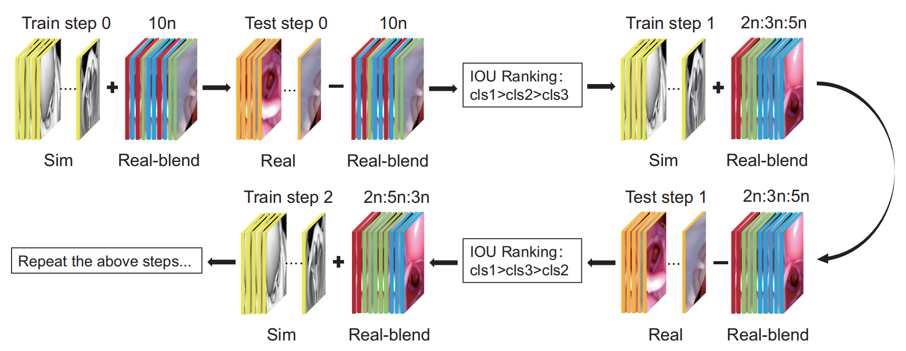
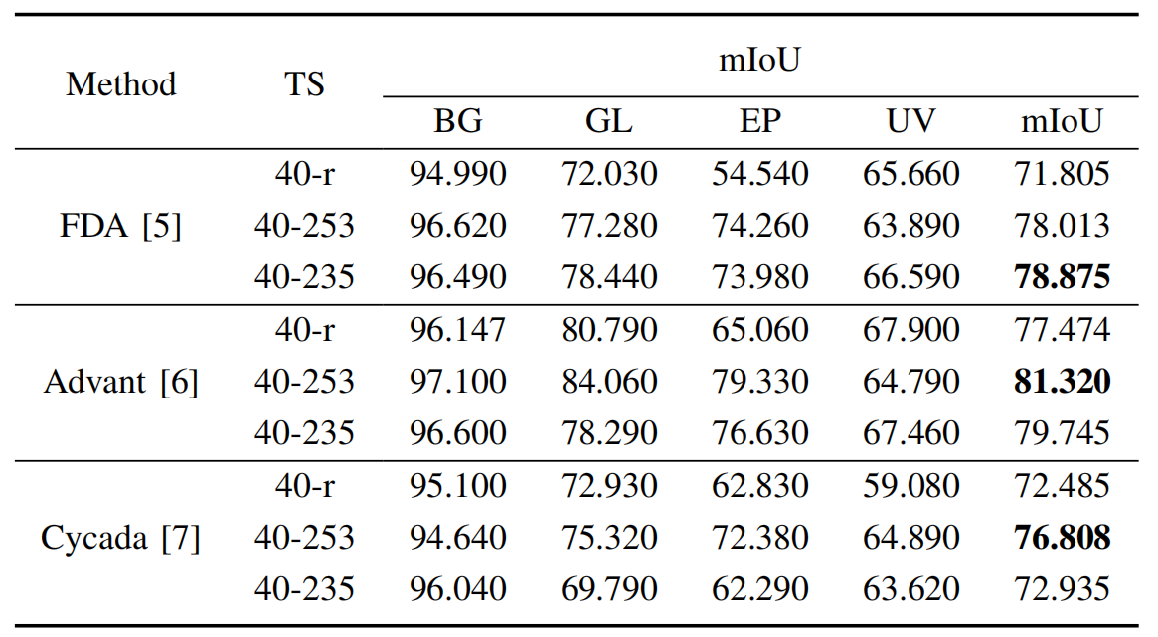



Domain Adaptive Sim-to-Real Segmentation of Oropharyngeal Organs
Towards Robot-assisted Intubation
Guankun Wang$^{1}$, Tian-Ao Ren$^{2,4}$, Jiewen Lai$^{1}$, Long Bai$^{1}$, Hongliang Ren$^{1,3∗}$ (Senior Member, IEEE)
$^{1}$ Dept. of Electronic Engineering, The Chinese University of Hong Kong
$^{2}$ College of Mechanical and Electrical Engineering, Beijing University of Chemical Technology
$^{3}$ Dept. of Biomedical Engineering, National University of Singapore
$^{4}$ Shenzhen Research Institute, The Chinese University of Hong Kong
[* Corresponding author]
Motivation
Robot-assisted transoral tracheal intubation makes intubation more effective.
It is challenging to obtain real datasets of oropharyngeal organs due to patient privacy and licensing.
Segmentation performance will decline rapidly when the differences between datasets become significant.
Key Contributions
An image segmentation method targeting domain adaptive Sim-to-Real transfer;
IoU-Ranking Blend approach aiming at reducing the domain gap between datasets.
A style-transfer-based strategy to improve the network's training stability.
An open-sourced dataset EISOST.
Dataset Composition
(a) A flexible robotic endoscope guides the next step’s tracheal intubation
(b) SOFA phantom
(c) Real phantom
(d) Dataset example
Flow Chart of IoU-Ranking Blend
Blend images
The number of blended images
Three classes
Remove images
Quantitative Analysis
Conclusion
An image segmentation method targeting oropharyngeal organs with Sim-to-Real.
The dataset of oropharynx model with style transfer EISOST is released.
IoU-Ranking Blend (IRB) is introduced to domain adaptive segmentation models.
Style-transfer is employed to further reduce the difference between datasets from image style.
The domain adaptive segmentation models’ performance is improved with our method.
Possible future works include introducing our model into the assisted intubation robot.
References
[1] Yang, Y., & Soatto, S. (2020). Fda: Fourier domain adaptation for semantic segmentation. In Proceedings of the IEEE/CVF Conference on Computer Vision and Pattern Recognition (pp. 4085-4095).
[2] An, J., Huang, S., Song, Y., Dou, D., Liu, W., & Luo, J. (2021). Artflow: Unbiased image style transfer via reversible neural flows. In Proceedings of the IEEE/CVF Conference on Computer Vision and Pattern Recognition (pp. 862-871).
Paper
Code

